Slide 1
SUMMER INTERNSHIP
Ambient Light Sensing System
By : Karnati Dhanush Reddy
Roll No : 2451-22-737-002
Department : IT
Team Coordinator : Dr.Ch.Samson

Slide 2
Contents
Abstract
Introduction
Problem Statement
Existing System
Proposed System
System Requirements
System Archtecture
Results and Analysis
Conclusion
Refehkm

Slide 3
ABSTRACT
Ambient light sensing systems are used in various applications, especially in automation and energy efficiency projects. One such system is the Day-Night PhotoCell Sensor. The sensor works by detecting the intensity of ambient light. During the day, when there is sufficient sunlight, the photocell senses high levels of light and sends a signal to switch off the connected light. One of the most significant advantage of an ambient light sensing system is energy saving. By turning off lights during the day and only using them when needed, it minimizes unnecessary electricity consumption.

Slide 4
INTRODUCTION
The system is relatively simple to install and integrate with existing lighting setups.
The components of the system are compact and can be easily fitted into various environments.
Future systems may leverage AI to learn and predict lighting needs, optimizing energy usage based on historical data and environmental trends.
The future of ambient light sensing systems is promising, with a range of potential advancements and applications.

Slide 5
PROBLEM STATEMENT
To develop an AMBIENT LIGHT SENSING SYSTEM that utilizes a Day - Night Photocell Sensor to automatically detect ambient light levels and control lighting devices

Slide 6
EXISTING SYSTEM
Delayed switching of lights, causing lights to stay on longer than needed or turn on too early.
The sensor may either switch the lights on or off based on a fixed light intensity, which may not suit the varying needs of different environments.
The timing of the light switching may not always align perfectly with the natural lighting changes , leading to improper light control.

Slide 7
PROPOSED SYSTEM
This hybrid approach allows the system to more accurately detect and respond to ambient light conditions, reducing false triggers.
The sensors can automatically adjust their sensitivity based on environmental conditions to ensure optimal performance in varying light conditions.
Sensors will be made more robust with improved weatherproofing and dust resistance.

Slide 8
HARDWARE REQUIREMENTS
Photoresistor : Detects light intensity. Its resistance decreases with increasing light intensity
Resistors : To create a voltage divider with the LDR.To set the reference voltage for the comparator.
Wires and Connectors : For making connections between components.
Power Supply : Typically 5V or 12V DC, depending on the components used.
LED Light : For indication or testing purposes.

Slide 9
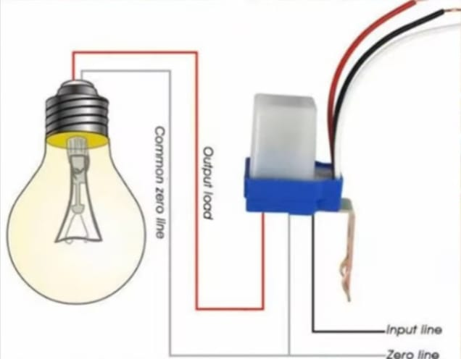
SCHEMATIC DIAGRAM

Slide 10
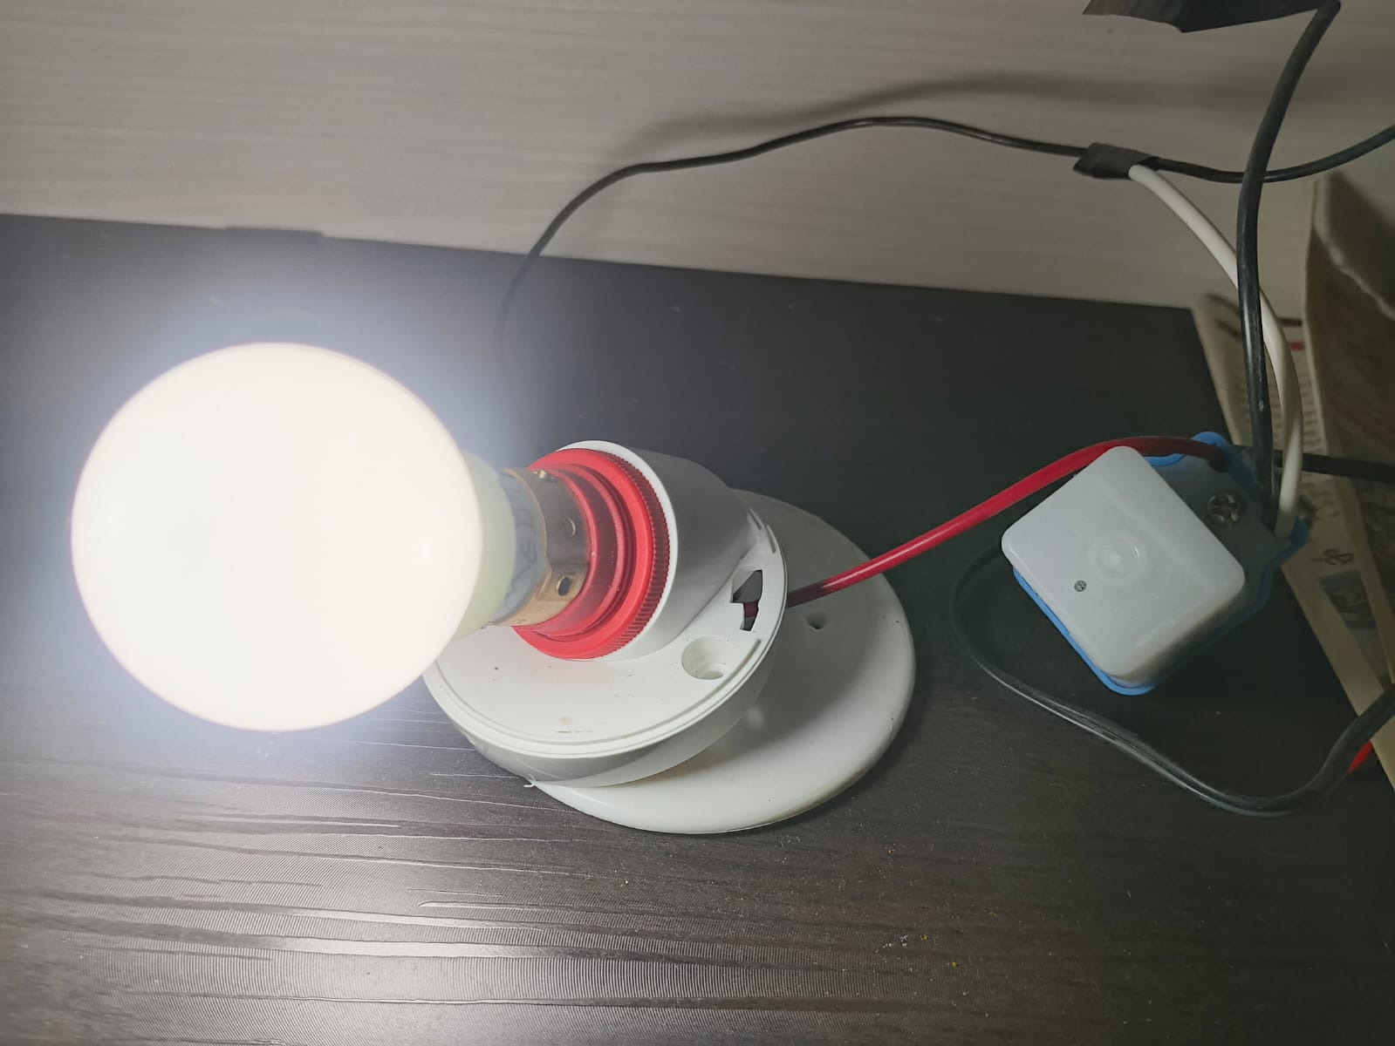
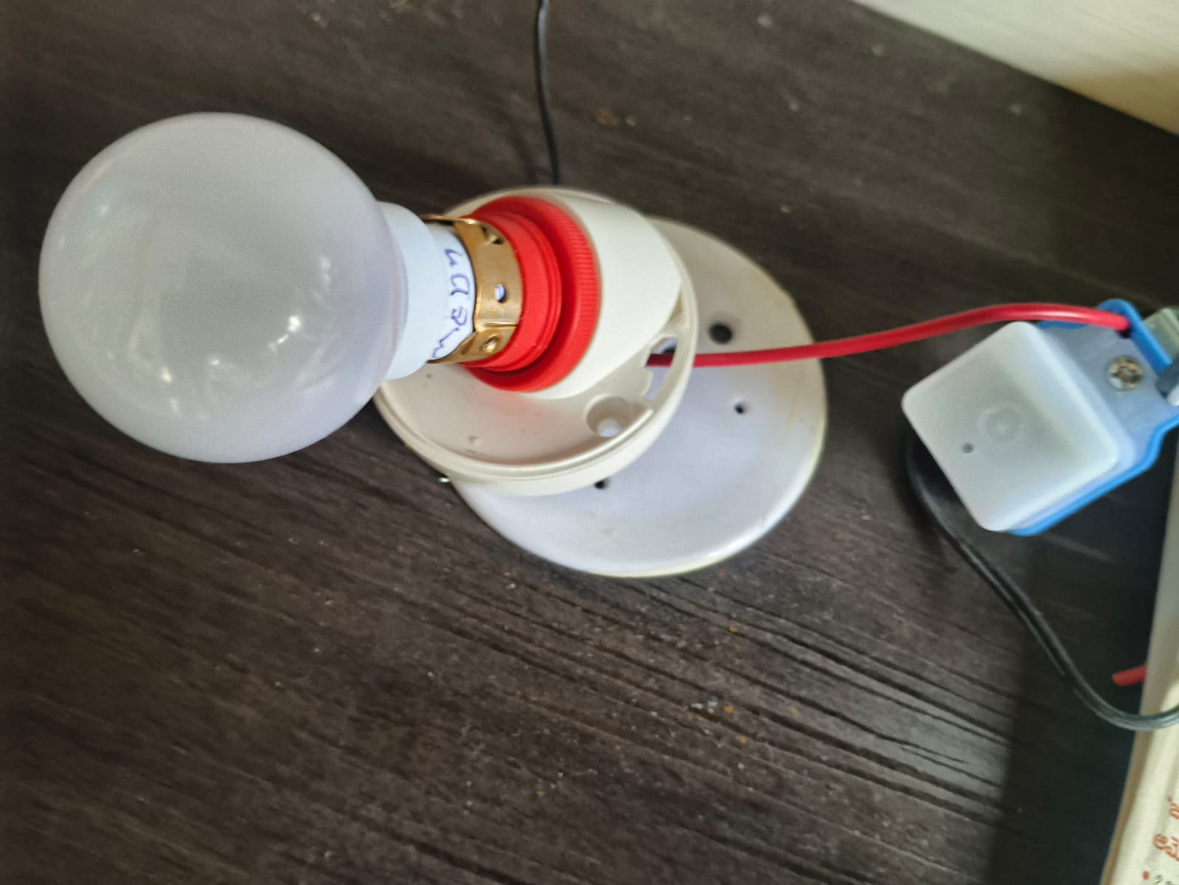
RESULTS
Device when it’s surroundings are dark
Device when it’s surroundings are light

Slide 11
CONCLUSION
It is a practical and energy-efficient solution for automatically controlling lighting based on ambient light levels.
Night light sensors are simple to use, cost-effective, and contribute to reducing energy consumption.
The sensor helps to turn the light on when darkness falls and off when it gets bright, eliminating the need for manual operation.
This results in energy savings and enhanced convenience.

Slide 12


